Slide 1

Fundamental Law of Memory Recall
Final Project Presentation for
Physical Models of Living Systems Course
By Ehsan Eslami Shafigh
Instructor: Prof. Samir Suweis
Notes:
NOTE:
To change the image on this slide, select the picture and delete it. Then click the Pictures icon in the placeholder to insert your own image.

Slide 2
The Outline
A Model Of Episodic Memory
The Prediction of The Model for The Number of Recalled Items
Analytical Solution: Asymmetric SM
Analytical Solution: Symmetric SM
Simulations
Experimental Evidence
More Details for Analytical Solution of The Symmetric SM

Slide 3

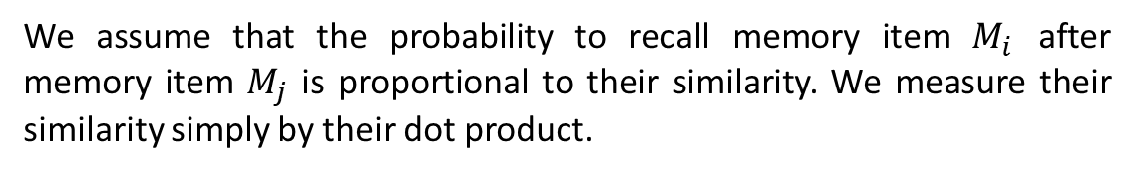

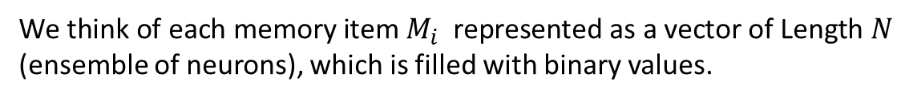
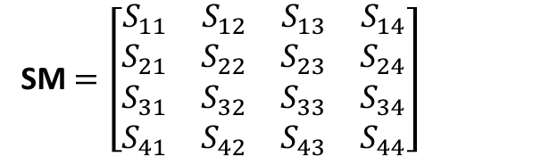

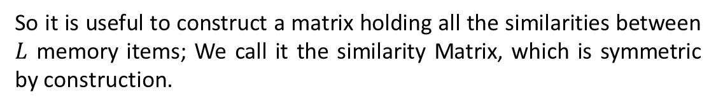

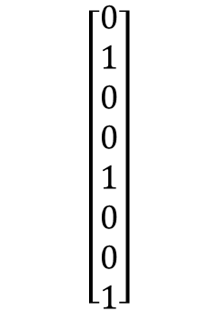
A Model Of Episodic Memory
$$\left[\begin{matrix}0 \\ 1 \\ 0 \\ 0 \\ 1 \\ 0 \\ 0 \\ 1\end{matrix}\right]$$
We think of each memory item $M_{i}$ represented as a vector of Length $N$ (ensemble of neurons), which is filled with binary values.
$$N$$
We assume that the probability to recall memory item $M_{i}$ after memory item $M_{j}$ is proportional to their similarity. We measure their similarity simply by their dot product.
$$f:The sparsity of the vector$$
$$Similarity of memory item i to memory item j: S_{ij}= {\vec{M}}_{i} . {\vec{M}}_{j}$$
So it is useful to construct a matrix holding all the similarities between $L$ memory items; We call it the similarity Matrix, which is symmetric by construction.
SM $=\left[\begin{matrix}S_{11} & S_{12} & S_{13} & S_{14} \\ S_{21} & S_{22} & S_{23} & S_{24} \\ S_{31} & S_{32} & S_{33} & S_{34} \\ S_{41} & S_{42} & S_{43} & S_{44}\end{matrix}\right]$
$$L$$
$$L$$

Slide 4

A Model Of Episodic Memory: The Recall Process Rules
Rule 1) The next memory item to be recalled, is the item with the maximum similarity to the current one:
$$\left[\begin{matrix}S_{11} & S_{12} & S_{13} & S_{14} \\ S_{21} & S_{22} & S_{23} & S_{24} \\ S_{31} & S_{32} & S_{33} & S_{34} \\ S_{41} & S_{42} & S_{43} & S_{44}\end{matrix}\right]$$
Current M
Next M

Slide 5

A Model Of Episodic Memory: The Recall Process Rules
Rule 2) If the memory item most similar to the current one is the one we just visited, then we take the second most similar item.
$$\left[\begin{matrix}S_{11} & S_{12} & S_{13} & S_{14} \\ S_{21} & S_{22} & S_{23} & S_{24} \\ S_{31} & S_{32} & S_{33} & S_{34} \\ S_{41} & S_{42} & S_{43} & S_{44}\end{matrix}\right]$$
Current M
Next M
Next M

Slide 6
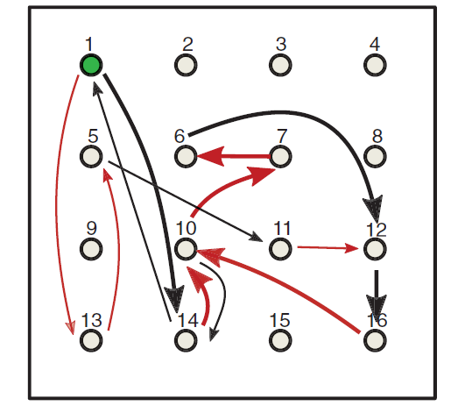
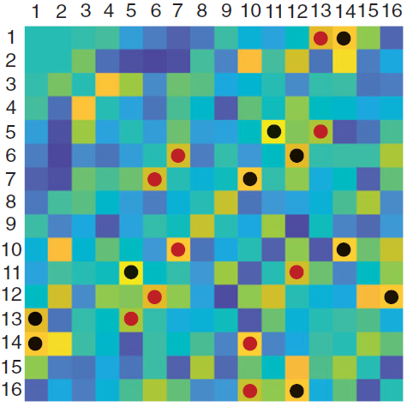
The Recall Process: Illustration

Slide 7
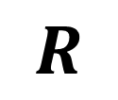

Model’s Prediction For # of Recalled Items:
Let’s say we have a total number of $L$ memory items presented to our subjects. Let the number of the items recalled be $R$. How does $R$ depend on $L?$
$$R$$
$$L$$

Slide 8
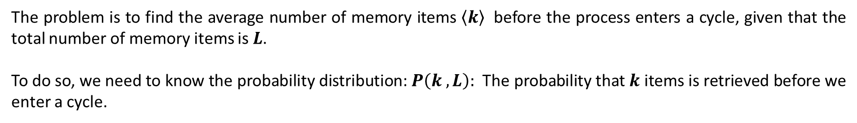
Model’s Prediction For # of Recalled Items: Analytical Solution
In the limit of $f≪1$, the SM matrix can be assumed to be a random symmetric matrix, as the correlation between different memory items can be neglected.
The problem is to find the average number of memory items $\left\langle k\right\rangle$ before the process enters a cycle, given that the total number of memory items is $L$.
To do so, we need to know the probability distribution: $P\left(k , L\right):$The probability that $k$ items is retrieved before we enter a cycle.

Slide 9
Analytical Solution: The Simpler Case of Asymmetric SM
To begin with, we can loosen rule number 2 for the recall process which complicates things.
The motivation behind rule number 2 is to prevent the process from getting locked in a two-items loop, when the SM is symmetric.
If B is most similar to A
A
B
Then A is most similar to B, with $≈$0.5 probability
Therefore, if we assume the SM is asymmetric, rule 2 will have no use anymore, and we can ignore it.

Slide 10
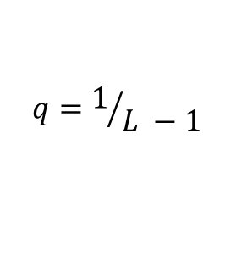
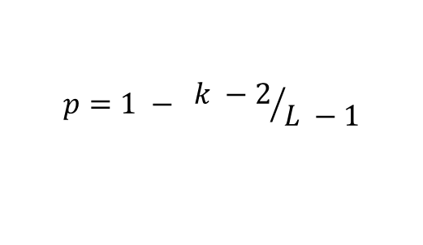

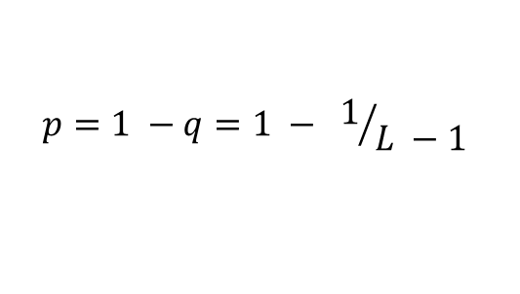

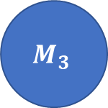
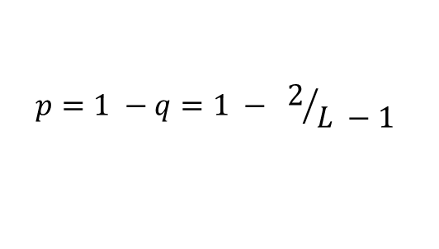

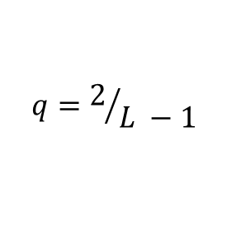


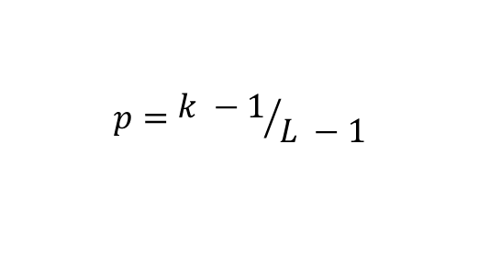
Analytical Solution: Asymmetric SM
We want to know the probability of retrieving $k$memory items, before entering a cycle, assuming that in total there are $L$ memory items available.
$$p=1 − {k −2}/{L −1}$$
$$p=1 −q=1 − 1/{L −1}$$
$$p=1$$
$$M_{4}$$
$$M_{k}$$
$$M_{1}$$
$$M_{3}$$
$$M_{2}$$
$$p=1 −q=1 − 2/{L −1}$$
$$q=2/{L −1}$$
$$q=1/{L −1}$$
$$p={k −1}/{L −1}$$
$$P\left(k , L\right)=\left(1 − \frac{1}{L −1}\right)\left(1 − \frac{2}{L −1}\right)…\left(1 − \frac{k −2}{L −1}\right)\left(\frac{k −1}{L −1}\right)$$

Slide 11





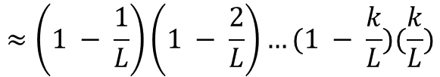
Analytical Solution: Asymmetric SM
$$P\left(k , L\right)=\left(1 − \frac{1}{L −1}\right)\left(1 − \frac{2}{L −1}\right)…\left(1 − \frac{k −2}{L −1}\right)\left(\frac{k −1}{L −1}\right)$$
$$L ≫k≫1$$
$$≈\left(1 − \frac{1}{L}\right)\left(1 − \frac{2}{L}\right)…(1 − \frac{k}{L})(\frac{k}{L})$$
$$x ≪1 : e^{−x}≈1 −x$$
$$≈e^{−1/L}{×e}^{−2/L} ×… ×e^{−k/L} ×\frac{k}{L}$$
$$= \frac{k}{L} e^{−\sum_{i=1}^{k}{(\frac{i}{L})}} ≈\frac{k}{L}e^{−\frac{k^{2}}{2L}}$$
$$k ≫1:\frac{k\left(k+1\right)}{2}≈\frac{k^{2}}{2}$$

Slide 12
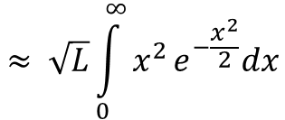
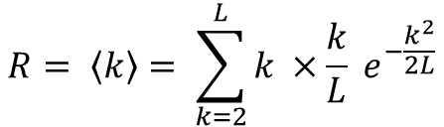
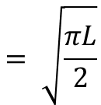
Analytical Solution: Asymmetric SM
$$R= \left\langle k\right\rangle = \sum_{k=2}^{L}{k ×\frac{k}{L} e^{−\frac{k^{2}}{2L}}}$$
$$≈ \sqrt{L}\int_{0}^{∞}{x^{2}}e^{−\frac{x^{2}}{2}}dx$$
$$= \sqrt{\frac{πL}{2}}$$

Slide 13

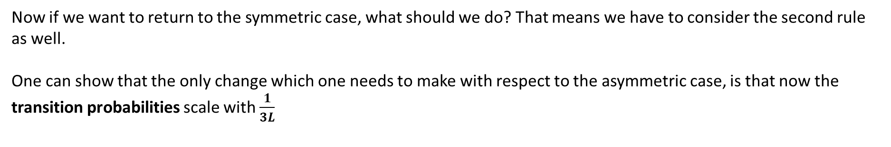
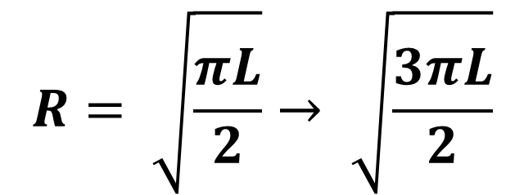
Analytical Solution: What if we consider the symmetric SM?
Now if we want to return to the symmetric case, what should we do? That means we have to consider the second rule as well.
One can show that the only change which one needs to make with respect to the asymmetric case, is that now the transition probabilities scale with $\frac{1}{3L}$
$$\frac{1}{L} →\frac{1}{3L}$$
$$R= \sqrt{\frac{πL}{2}}→ \sqrt{\frac{3πL}{2}}$$

Slide 14
Symmetric SM: Numerical Simulations
def sequencer(sm):
sequence_length = 3 * len(sm) # one can play with sequence length
sequence = np.zeros(sequence_length , dtype = int) # We save the index of memory items in this array
for i in range(sequence_length - 1):
first_largest_index = m_th_largest_index(sm[sequence[i]] , 2)
second_largest_index = m_th_largest_index(sm[sequence[i]] , 3)
if first_largest_index != sequence[i-1]: sequence[i+1] = first_largest_index
else: sequence[i+1] = second_largest_index
return sequence
k = len(np.unique(sequence))

Slide 15


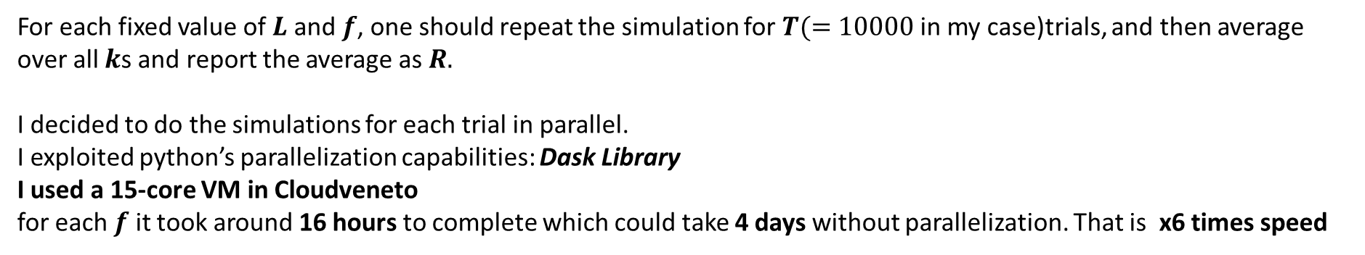
Symmetric SM: Numerical Simulations
For each fixed value of $L$ and $f$, one should repeat the simulation for $T(=10000$ in my case)trials, and then average over all $k$s and report the average as $R.$
I decided to do the simulations for each trial in parallel.
I exploited python’s parallelization capabilities: Dask Library
I used a 15-core VM in Cloudveneto
for each $f$ it took around 16 hours to complete which could take 4 days without parallelization. That is x6 times speed

Slide 16
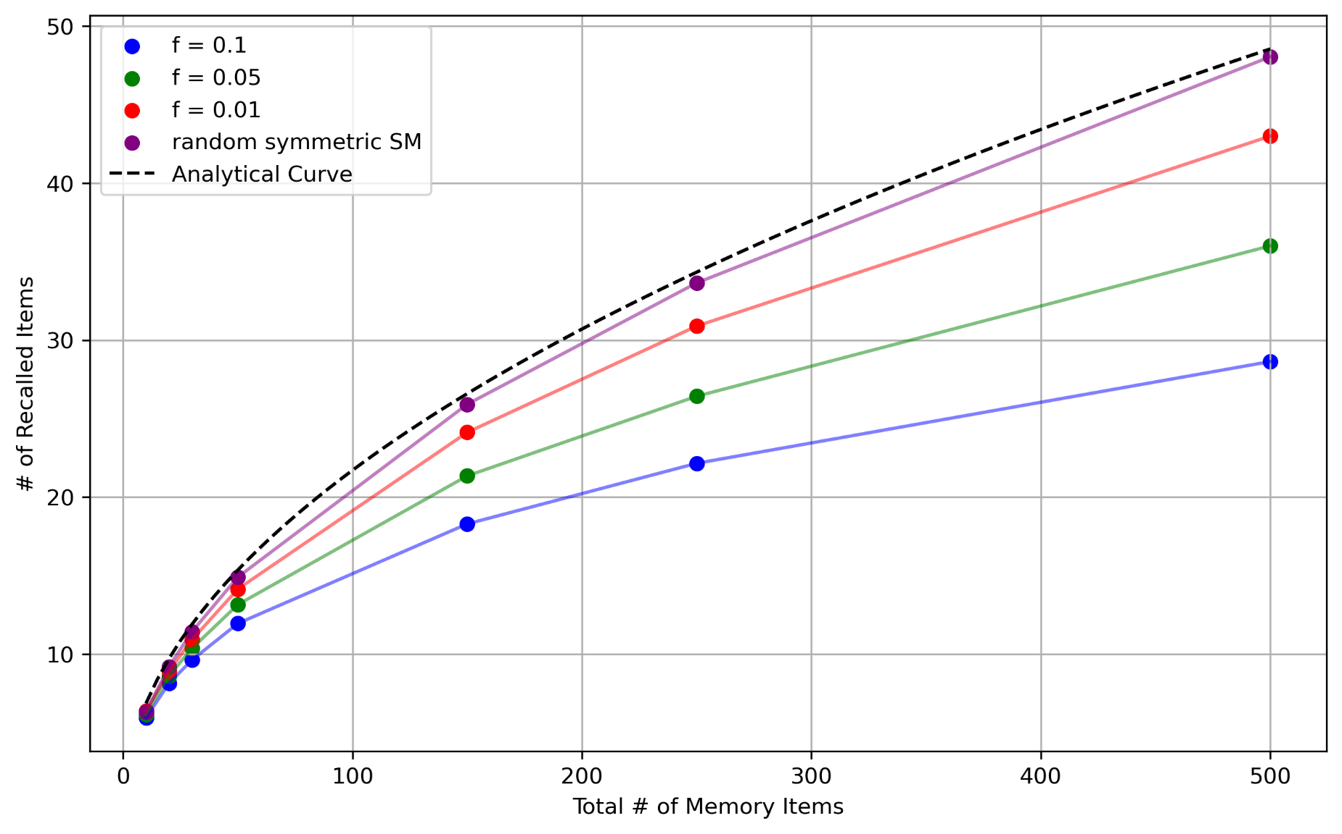
Symmetric SM: Numerical Simulations

Slide 17
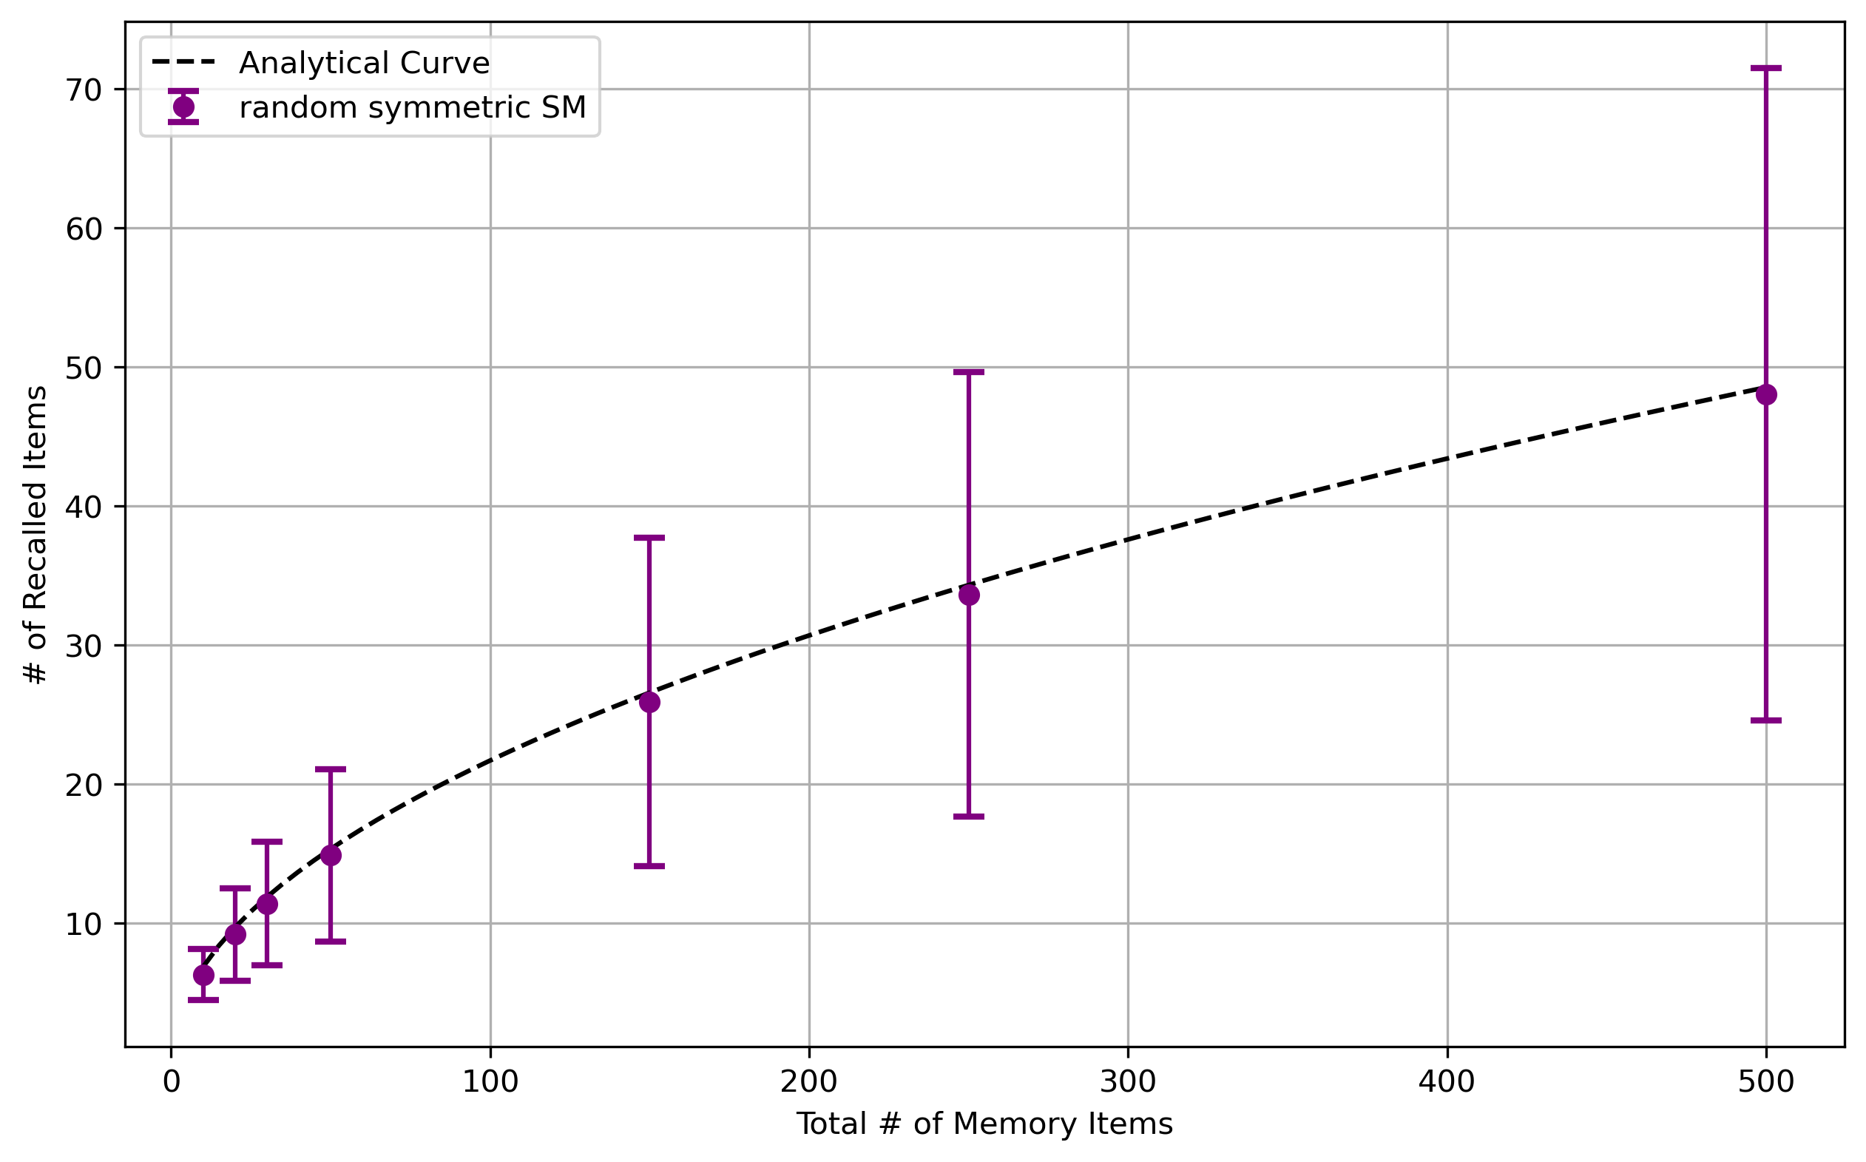
Symmetric SM: Numerical Simulations

Slide 18
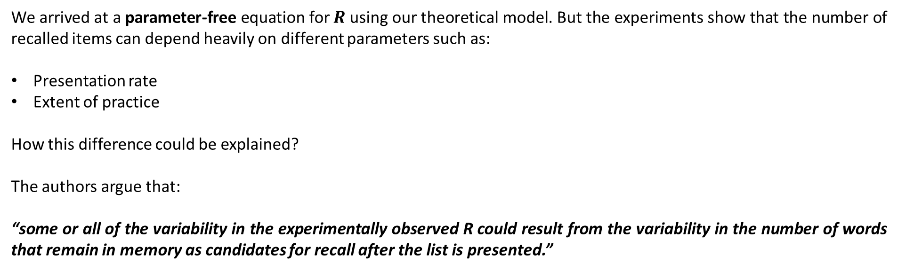
Experimental Results: How The Variability Could Be Explained?
We arrived at a parameter-free equation for $R$ using our theoretical model. But the experiments show that the number of recalled items can depend heavily on different parameters such as:
Presentation rate
Extent of practice
How this difference could be explained?
The authors argue that:
“some or all of the variability in the experimentally observed R could result from the variability in the number of words that remain in memory as candidates for recall after the list is presented.”

Slide 19
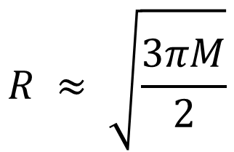
How The Variability Could Be Explained? Corrected Equation for R
Let’s call the number of the word that remain in the memory $M$. Then the corrected equation for $R$ reads:
$$R ≈ \sqrt{\frac{3πM}{2}}$$
Experimentally, they measure $M$, by performing a “recognition test” on the subject before the recall test. In this way they are able to confirm the above result.

Slide 20
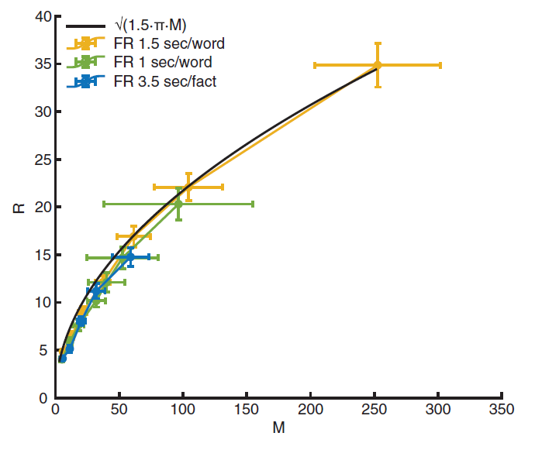
Corrected Equation for R: The Experimental Evidence

Slide 21
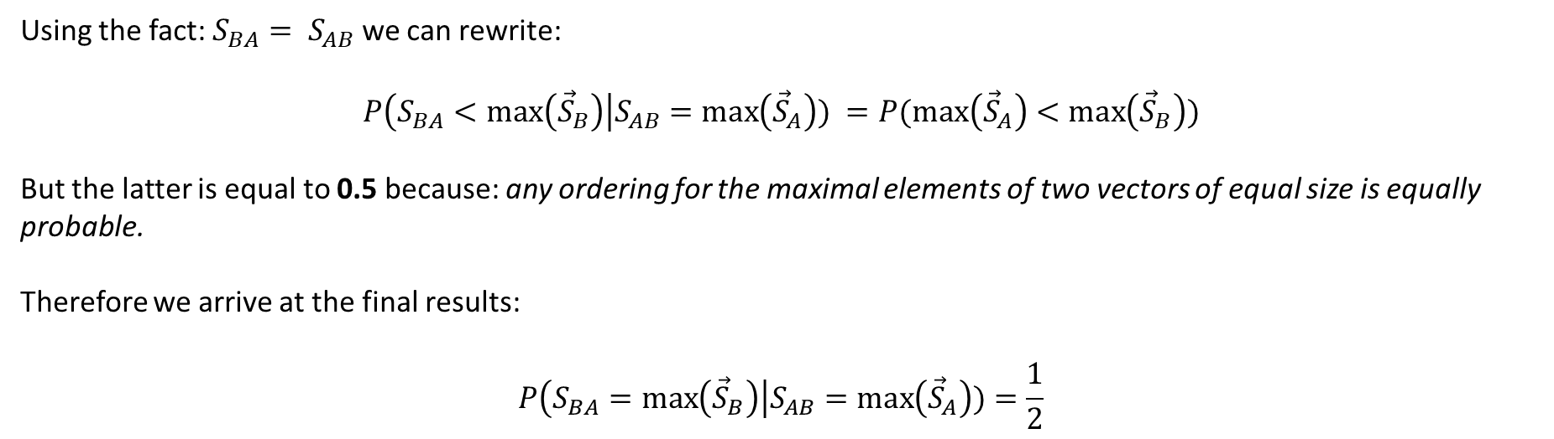
Analytical Solution: Avoiding Two-Item Loops with Symmetric SM
One needs to consider the second rule as well, when dealing with the symmetric SM. As we mentioned earlier, the reason is that if the matrix is symmetric, then if B is most similar to A, with a probability of approximately 0.5, A is also most similar to be. In mathematical terms we are interested in:
$$P\left(S_{BA}=\max\left({\vec{S}}_{B}\right)\right|S_{AB}=\max\left({\vec{S}}_{A}\right)) =1 −P\left(S_{BA}<\max\left({\vec{S}}_{B}\right)\right|S_{AB}=\max\left({\vec{S}}_{A}\right))$$
Using the fact: $S_{BA}= S_{AB}$ we can rewrite:
$$P\left(S_{BA}<\max\left({\vec{S}}_{B}\right)\right|S_{AB}=\max\left({\vec{S}}_{A}\right)) =P(max\left({\vec{S}}_{A}\right)<\max\left({\vec{S}}_{B}\right))$$
But the latter is equal to 0.5 because: any ordering for the maximal elements of two vectors of equal size is equally probable.
Therefore we arrive at the final results:
$$P\left(S_{BA}=\max\left({\vec{S}}_{B}\right)\right|S_{AB}=\max\left({\vec{S}}_{A}\right))=\frac{1}{2}$$

Slide 22
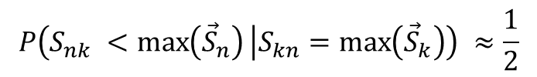





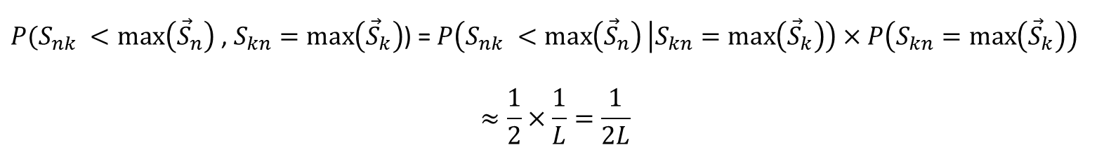
Analytical Solution: Second Rule in Mathematical Terms
$$M_{3}$$
$$M_{n}$$
$$M_{k}$$
$$M_{1}$$
$$M_{2}$$
$$P\left(S_{nk} <\max\left({\vec{S}}_{n}\right) | S_{kn}=\max\left({\vec{S}}_{k}\right)\right) ≈\frac{1}{2}$$
$P(S_{nk} <\max\left({\vec{S}}_{n}\right)$ , $S_{kn}=\max\left({\vec{S}}_{k}\right)$) = $P\left(S_{nk} <\max\left({\vec{S}}_{n}\right) | S_{kn}=\max\left({\vec{S}}_{k}\right)\right)$ $×P\left(S_{kn}=\max\left({\vec{S}}_{k}\right)\right)$
$$≈\frac{1}{2}×\frac{1}{L}=\frac{1}{2L}$$

Slide 23






Analytical Solution: The Probability for a New Subtrajecroty
$$M_{1}$$
$$M_{k}$$
$$M_{j}$$
$$M_{n}$$
$$M_{2}$$
$$P\left(S_{jn} <max⁡({\vec{S}}_{j}) \right| S_{nj}=\max\left({\vec{S}}_{n}\right)) = P(\max\left({\vec{S}}_{n}\right)<\max\left({\vec{S}}_{j}\right))$$
$P(\max\left({\vec{S}}_{n}\right)<max⁡({\vec{S}}_{j})|$ $\max\left({\vec{S}}_{k}\right)<max⁡({\vec{S}}_{n}))≈\frac{1}{3}$
any ordering for the maximal elements of three vectors of equal size is equally probable.

Slide 24


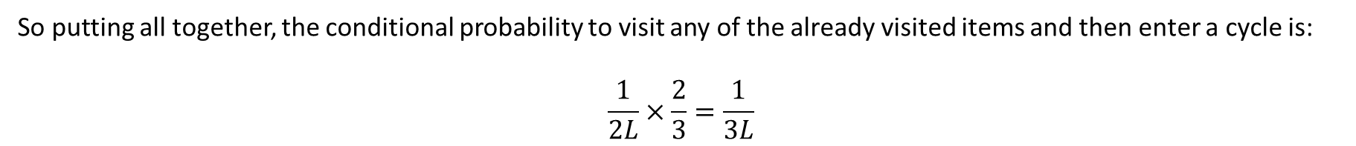
Analytical Solution: The Probability to Enter a Cycle After Visiting $k$ Memory Items
But we are interested in the probability to enter a cycle after visiting memory item $n:$
$$P\left(\max\left({\vec{S}}_{n}\right)>\max\left({\vec{S}}_{j}\right) | \max\left({\vec{S}}_{k}\right)<\max\left({\vec{S}}_{n}\right)\right)=1 −P\left(\max\left({\vec{S}}_{n}\right)<\max\left({\vec{S}}_{j}\right) | \max\left({\vec{S}}_{k}\right)<\max\left({\vec{S}}_{n}\right)\right) ≈\frac{2}{3}$$
So putting all together, the conditional probability to visit any of the already visited items and then enter a cycle is:
$$\frac{1}{2L}×\frac{2}{3}=\frac{1}{3L}$$
$$\frac{1}{L} →\frac{1}{3L}$$

Slide 25
Thanks For Listening!
References:
Fundamental Law of Memory Recall Michelangelo Naim, Mikhail Katkov, Sandro Romani, and Misha Tsodyks Phys. Rev. Lett. 124, 018101 – Published 10 January 2020

